Slide 1
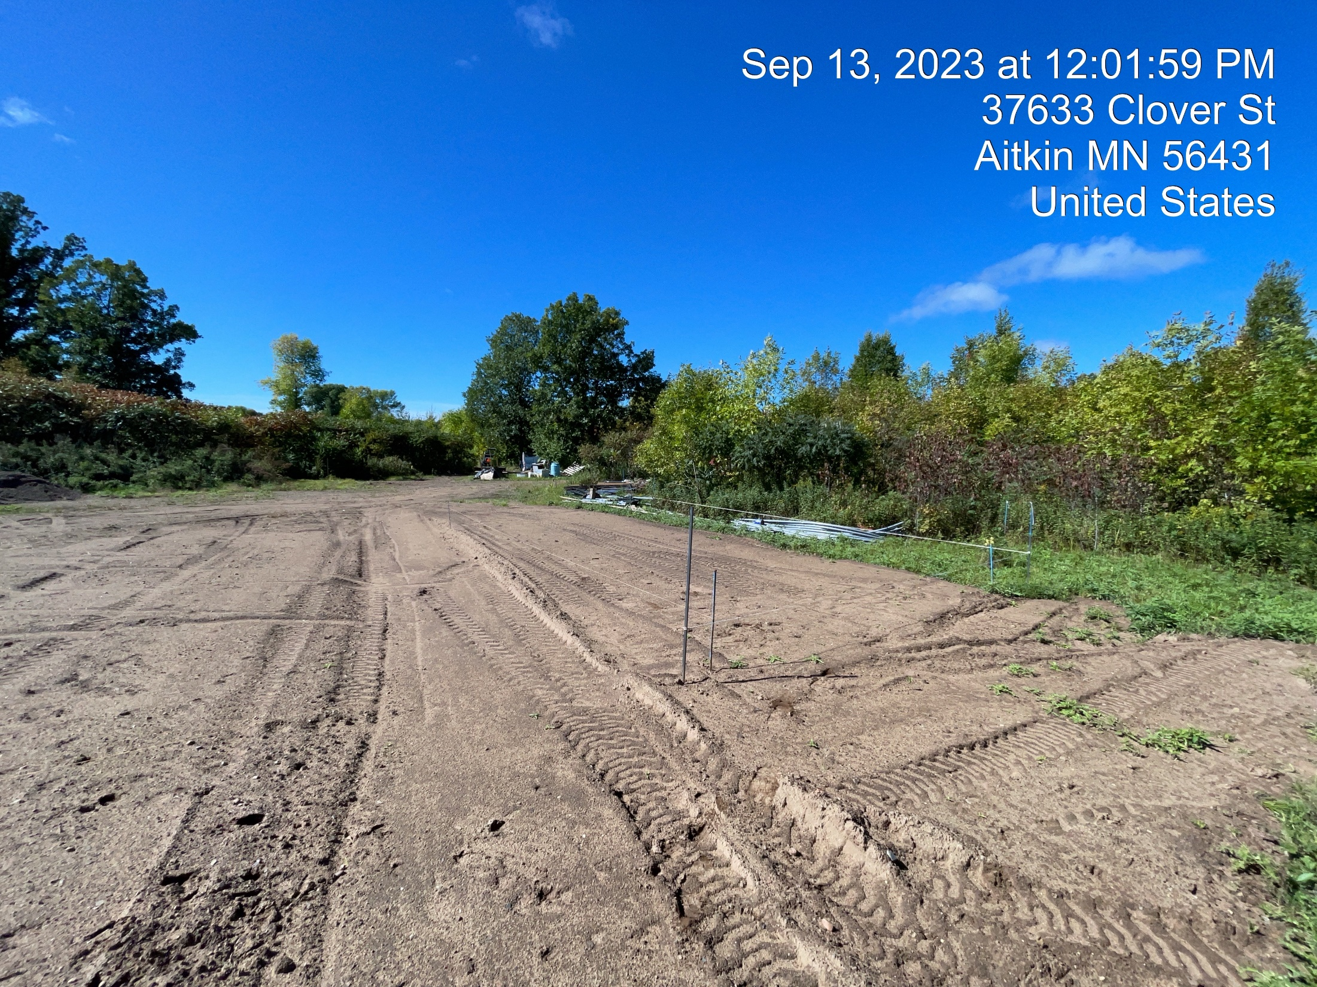
Maysembourg SHed

